Slide 1


Banking Project
Rani Guduru

Slide 2




Agenda Project is focused on analyzing and presenting key performance indicators (KPI’s) related to bank loans for customers. The following KPIs have been identified as important metrics for understanding loan trends and customer behavior
KPI 1: Year-wise loan amount stats
KPI 2: Grade and sub-grade-wise revol_bal
KPI 3: Total payment for verified status vs total payment for non-verified status
KPI 4: State-wise and last_credit_pull_d wise loan status
KPI 5: Home ownership vs last payment date stats

Slide 3




Introduction
Bank
A financial institution licensed to receive deposits and make loans. Banks may also provide financial services such as wealth management, currency exchange, and safe deposit boxes

Slide 4


Interactive Banking Dashboard
KPI 1- KPI 5 (Power Bi,Tableau)

Slide 5
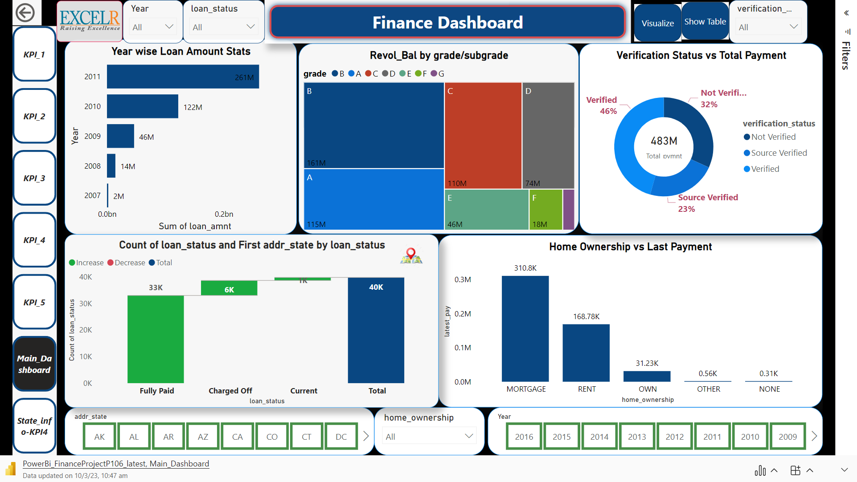
Chart

Slide 6

Key Takeaways

Slide 7
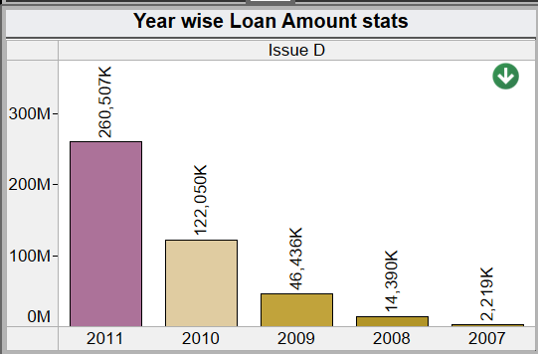
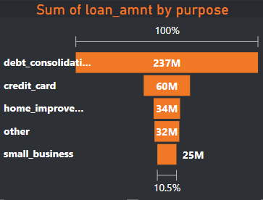
Year wise Loan Amount Stats
This KPI provides a comprehensive view of the loan amounts disbursed by the bank over the years. By analyzing this data, we can identify trends in loan amounts and make informed decisions about loan disbursements in the future.
For year 2011 --
Sum of Loan amount is 260,507K
Average Loan amount is 12K
Max Loan amount is 35K
2007 thru 2011, we can notice that the loan amount had been increasing and 2011 has the highest loan amount disbursed
When we compare the loan amount against the purpose, we notice that the ‘debt consolidation’ (purpose) has the highest sum of loan amount

Slide 8
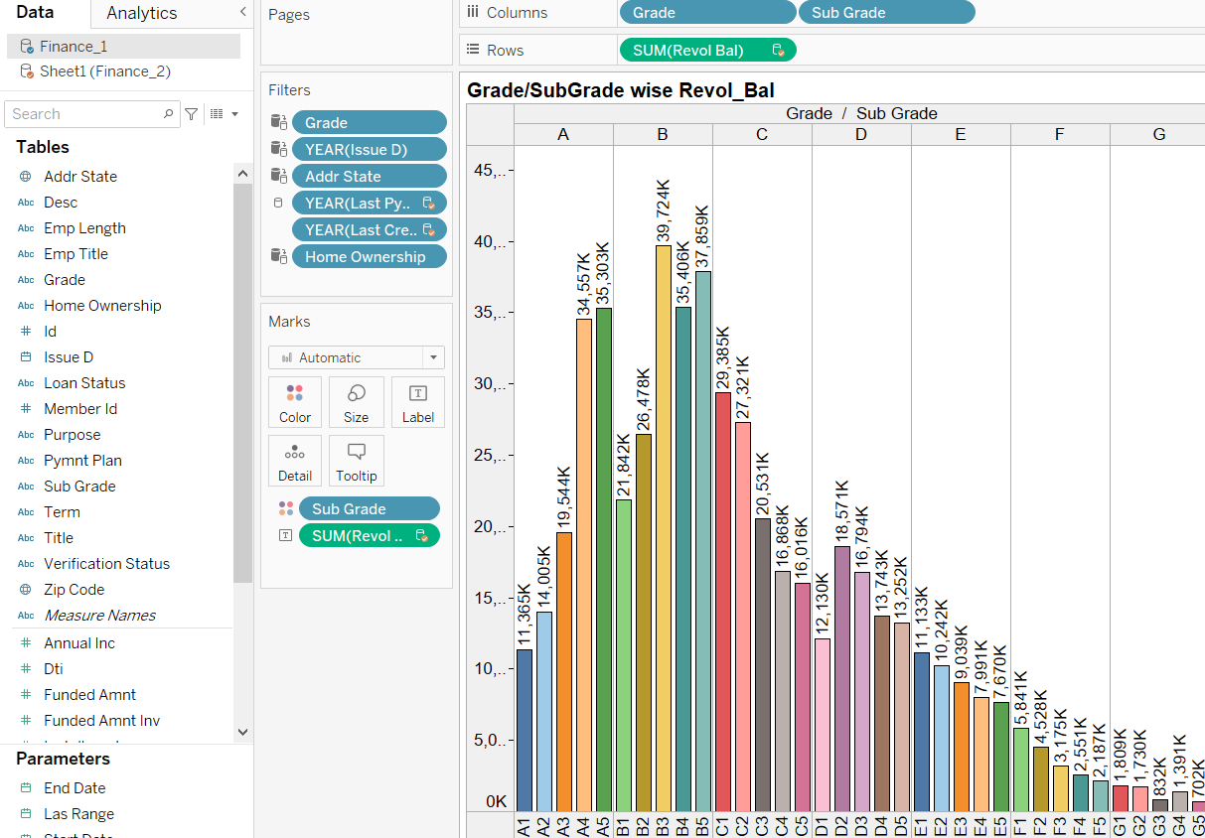
Grade and Sub-Grade wise Revolving balance
This KPI provides insights into the creditworthiness of customers based on their grade and sub-grade classification. By analyzing the revolving balance data, we can identify customers who are more likely to default on their loans and take appropriate actions to mitigate risk.
Let us understand what is Revol Bal
Revolving Balance: With revolving credit, a consumer has a line of credit they can keep using and repaying over and over. The balance that carries over from one month to the next is the revolving balance on that loan.
High revolving balances may indicate that a borrower is relying too much on credit. That is why it is important to keep revolving balances to a minimum.
This side-by-side bar chart from Tableau helps us understand that subgrade B3 (from B Grade) has highest revol bal of 39,724K and subgrade G5 (from G Grade) has lowest revol bal of 702K

Slide 9
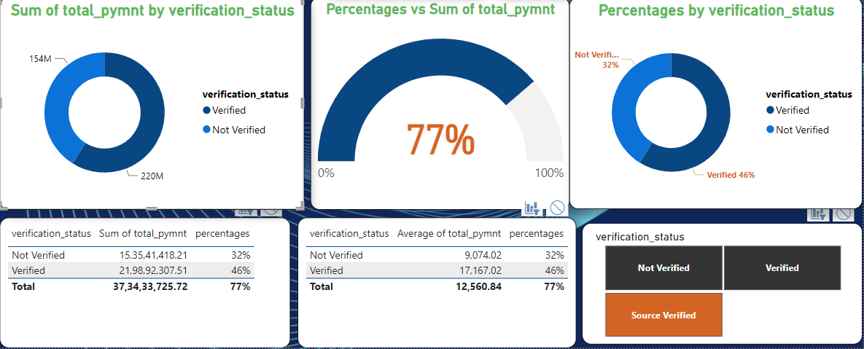
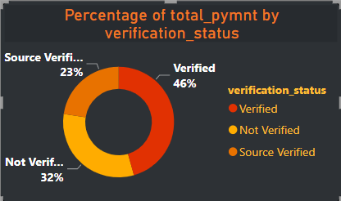
Total Payment for Verified vs Total Payment for Non-Verified Status
This KPI helps us understand the impact of verified income and employment status on loan repayment behavior. By comparing total payments made by customers who have verified income and employment status with those who have not, we can identify patterns in repayment behavior and adjust our lending policies accordingly.
Verification Status:
Verified
Source Verified
Not Verified
When we look at the total Payment amount for Verified, Not Verified and Semi Verified Verification Status, we find that Verified Status accounts have a highest total Payment of 219,892K which is 46% of the total payment

Slide 10
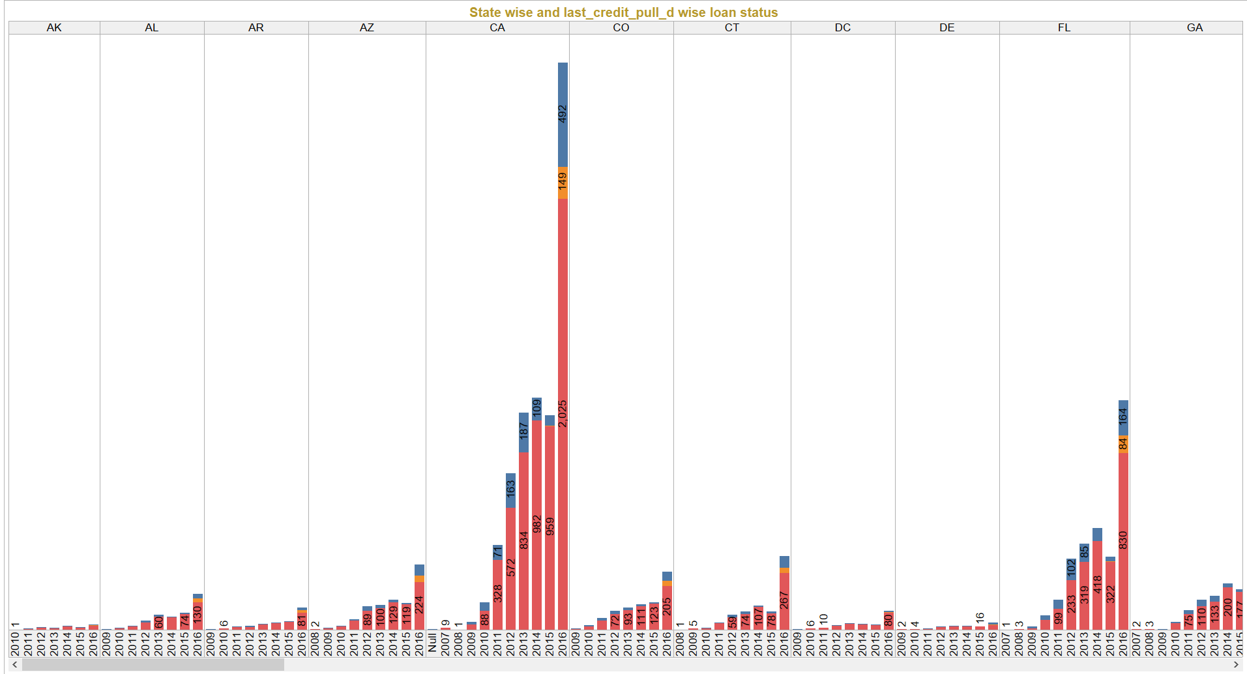
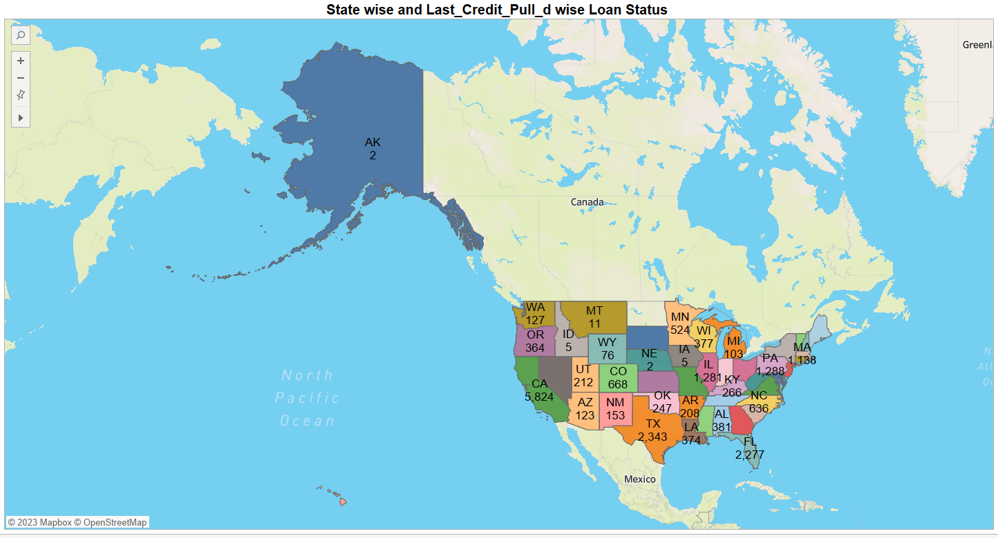
State wise Last Credit pulled date wise loan status
This KPI provides insights into the geographical and temporal trends in loan default rates. By analyzing loan status data by state and the last credit pull date, we can identify areas where defaults are more likely to occur and take steps to mitigate risk.
Loan Status:
Fully Paid
Charged Off
Current
CA state has maximum of 5824 fully paid accounts, 1125 charged off accounts and 150 current accounts among other states
In 2016, there is an increase in the charged off status accounts for all states.
Note: Charge-off means the lender or creditor has written the account off as a loss, and the account is closed to future charges. It may be sold to a debt buyer or transferred to a collection agency.

Slide 11
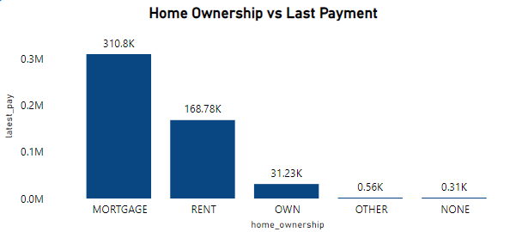
Home Ownership vs Last Payment Date Stats
This KPI helps us understand the impact of home ownership on loan repayment behavior. By analyzing data on the last payment date by home ownership status, we can identify patterns in repayment behavior and adjust our lending policies accordingly.
Home Ownerships:
Mortgage
Rent
Own
Other
None
Mortgage Accounts have highest Last Payment amount of 310.8K and None type home ownerships have least payment (0.31K)

Slide 12

Team
Rani Guduru
Aparna Ruturaj Haval
Aishwarya Suresh Randive
Ganesh Rajendra Patil
Sabir Hoda
Ajay Sunil Chandile
Vishal Guhania

Slide 13

Summary
Banking holds a crucial role in our day-to-day life. We must adhere to the banking system as responsible citizens. The banking system acts as a crucial base for the financial system as well as the entire economic system of the country.

Slide 14

Thank You
Rani Guduru
Rani.qa41@gmail.com
Follow me on:
www.linkedin.com/in/rani-subhan-776b5a227

